Slide 1
Lesson 6: Mathematical Models of Fluid Flow Components
ET 438a
Automatic Control Systems Technology

Slide 2
Learning Objectives
After this presentation you will be able to:
Define the characteristics of a fluid flow system
Identify if a fluid flow is Laminar or Turbulent based on fluid and system parameters.
Write mathematical models for fluid characteristics.
Develop an analogy between electrical characteristic and fluid system characteristics.
Solve for steady-state fluid flow using given mathematical modeling equations.

Slide 3
Liquid Flow Characteristics
Flow
Volume of liquid/unit time
(e.g. gallons/minute)
Current
(Coulombs/s)
Pressure
force/unit area
(e.g. lb/in²)
Potential
Difference
Flow Resistance
Pressure drop/unit flow
(e.g. lb/in²/gal)
Electrical
Resistance
Note: Flow resistance is either linear or non-linear. It depends on type of fluid flow, which is based on the fluid and piping parameters.

Slide 4
Fluid Flow Classifications
Types of liquid flow
Laminar Flow - low velocity flows. Stream lines are parallel. Liquid flows in layers. Linear flow resistance.
piping

Slide 5
Fluid Flow Classifications
Types of liquid flow
Turbulent - relatively high velocity flow. Liquid swirls and spins as it flows. Non-linear flow resistance.
piping
Flow type determined by the Reynold's Number

Slide 6
Determining Flow Types
Reynold's Number
Where ρ = density of the fluid (kg/m³)
v = average velocity of the fluid (m/s)
d = diameter of pipe (m)
μ = absolute viscosity of fluid (Pa-s)
Note: Reynold's number is dimensionless
Laminar flow : R<2000
Turbulent flow: R>4000
Transition flow: 2000< R< 4000

Slide 7
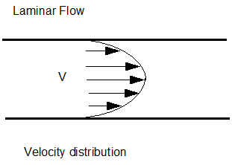
Determining Flow Types
Computing average velocity
Velocity profile changes across the cross section of pipes and ducts
V=max
Since pipe diameter is usually given
V=0
Where: A = area of pipe (m²)
Q = flow (m³/s)
d = pipe diameter (m)

Slide 8
Laminar Flow Equations
Laminar Flow Equations for Round Pipes
Where: p = pressure drop (Pascals)
R_{L} = laminar flow resistance
Q = flow (m³/s)
l = length of pipe (m)
μ = absolute viscosity (Pa-s)
d = pipe diameter (m)

Slide 9
Turbulent Flow Equations
Turbulent Flow Equations for Round Pipes
Where: f= friction factor (see table 3.3 p. 81 text)
l = length (m)
d = pipe diameter (m)
ρ = density of liquid (kg/m³)
R_{t} = turbulent flow resistance (Pa-s/m³)
p = pressure (Pa)
Q = flow (m³/s)

Slide 10

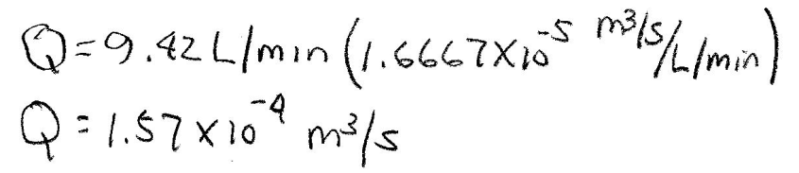
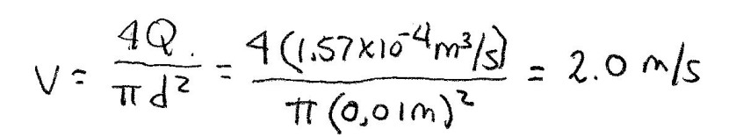
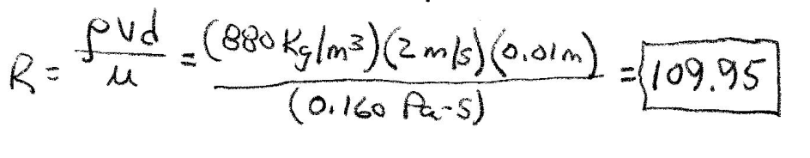
Laminar Flow Example
Example 6-1: Oil at a temperature of 15 C flows in a horizontal, 1 cm diameter tube with a flow rate of 9.42 L/min. Tube length is 10 m. Find: Reynold's number, flow resistance, pressure drop in tube.
Convert all units into SI units
All conversion factors are in the textbook appendix
Average
velocity
From Appendix A in textbook ρ=880 kg/m³ μ=0.160 Pa-s
Compute
Reynold’s
number
R<2000 so flow in Laminar. Linear relationship between flow and pressure drop.

Slide 11
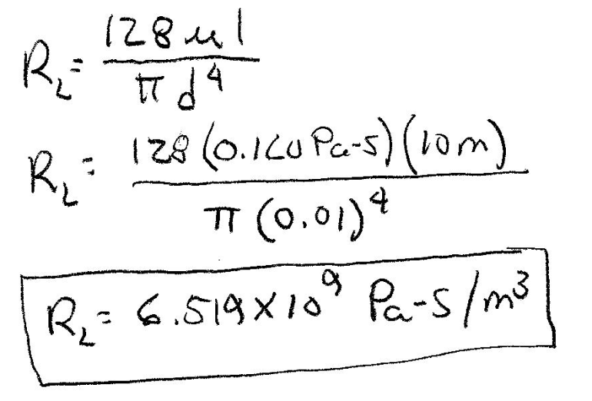
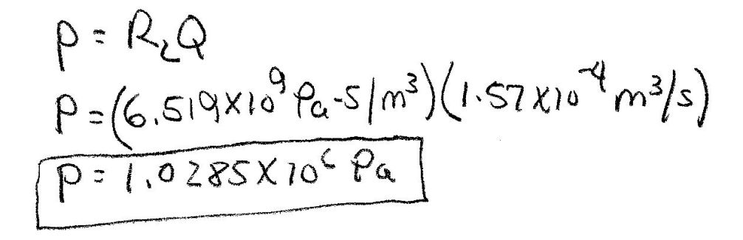
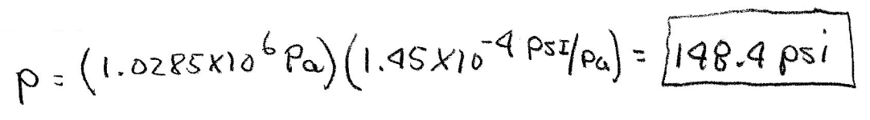
Laminar Flow Solution (2)
Compute Laminar flow resistance
Compute pressure drop
Convert to psi

Slide 12
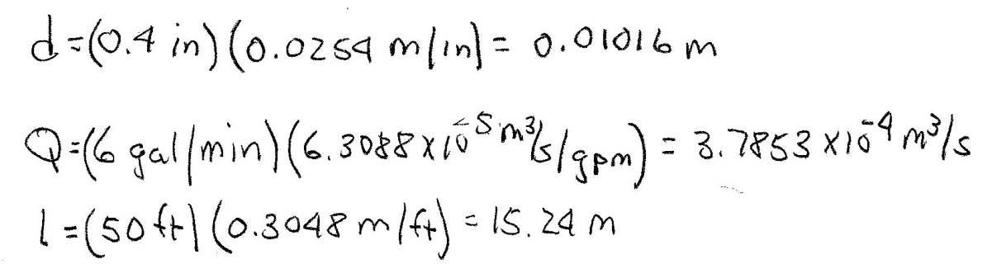
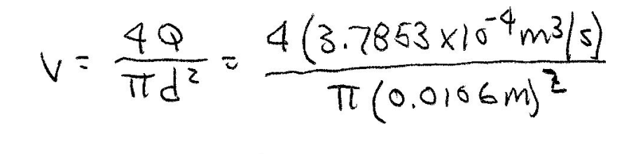
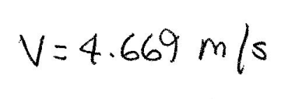
Turbulent Flow Example
Example 6-2: Water at 15 C flows through a commercial steel pipe with a diameter of 0.4 inch with a flow rate of 6 gal/min. The line is 50 ft long. Find: Reynold's number, flow resistance, pressure drop in pipe.
From Appendix A Density ρ=1000 kg/m³ Viscosity μ=0.001 Pa-s
Convert all English units to SI units
Find the average velocity

Slide 13
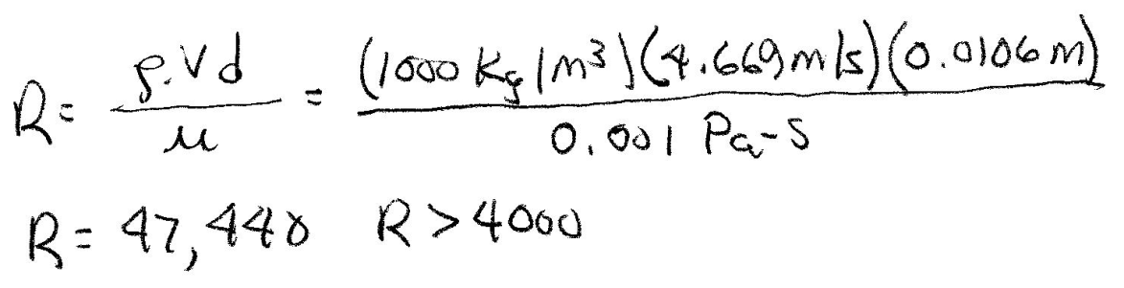
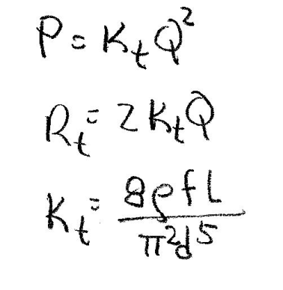
Turbulent Flow Solution (2)
Compute the Reynold’s number
R> 4000 so the flow is turbulent. Use the turbulent equations.
Turbulent equations require friction factors from Table 3-3 on page 81 of textbook.
Find f values from Table 3-3. Get values that bracket the
Computed value.
For commercial steel pipe: diameter 1-2 cm
R between R_{a}>10,000 R_{b}<100,000
f between f_{a}=0.035 f_{b}=0.028

Slide 14
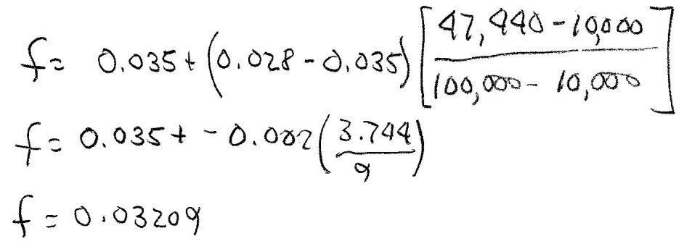
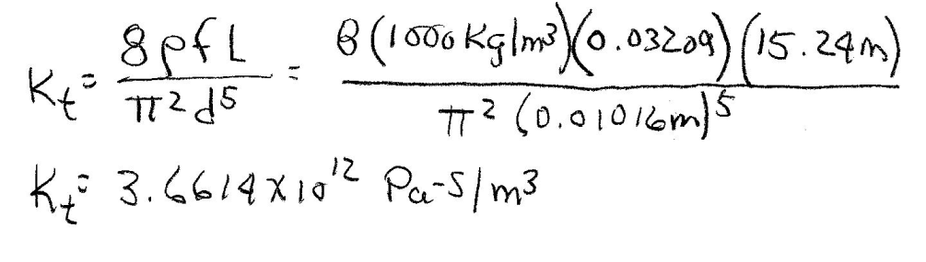
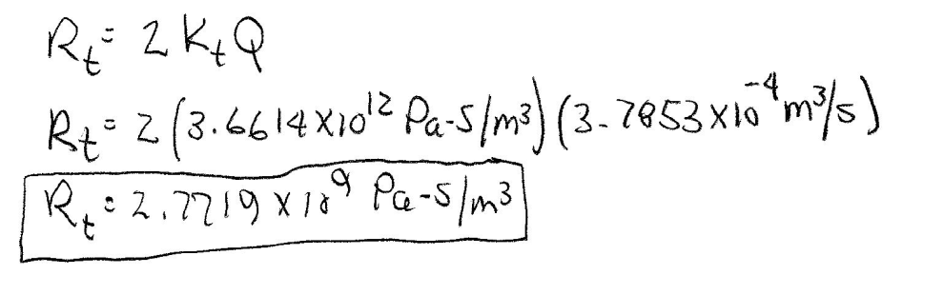
Turbulent Flow Solution (3)
Friction factor, f, must be between f_{a} and f_{b}
Now find K_{t}
Find R_{t}

Slide 15
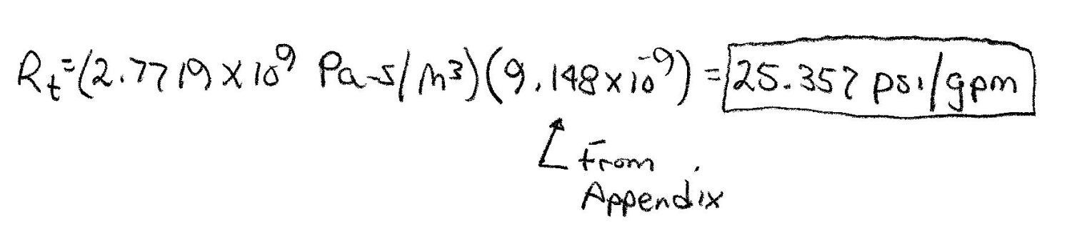
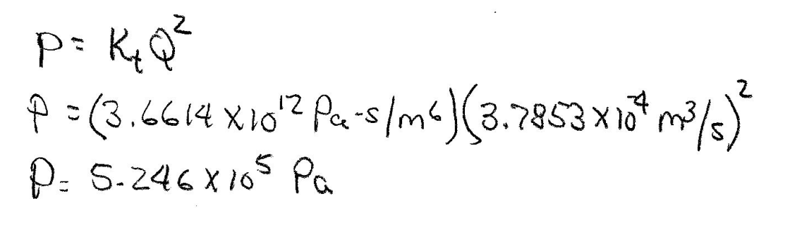
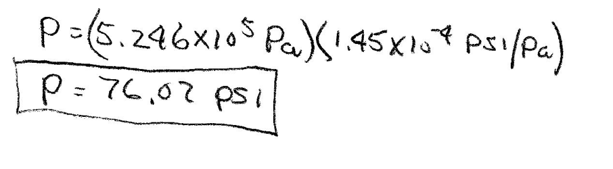
Turbulent Flow Solution (4)
Convert R_{t} to English units
Compute pressure drop
Convert P to English units

Slide 16
Liquid Flow Capacitance
Liquid Flow Capacitance - increase in volume of liquid required to produce unit increase in pressure
Where: C_{L} = capacitance (m³/Pa)
ΔV = volume change (m³)
Δp = pressure change (Pa)
Derive relationship for C_{L}.
Pressure relationship
Where: ρ = density of fluid
g = acceleration due to gravity
H = height of liquid in tank

Slide 17
Liquid Flow Capacitance Derivation
Find liquid flow capacitance in terms of tank parameters.
Final Equation

Slide 18
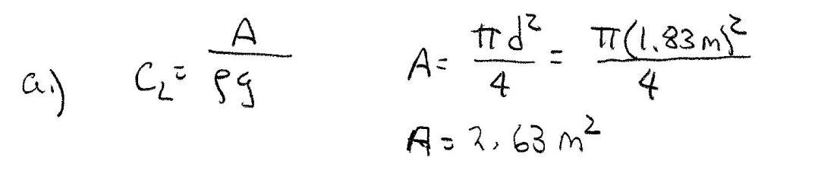
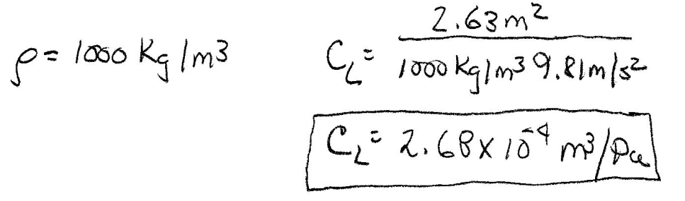
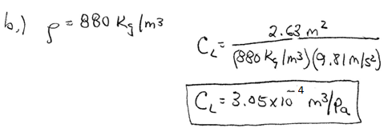
Fluid Capacitance Examples
Example 6-3: A tank has a diameter of 1.83 meters and a height of 10 ft. Determine the capacitance of the tank when it holds: a.) water b.) oil c.) kerosene d.) gasoline

Slide 19
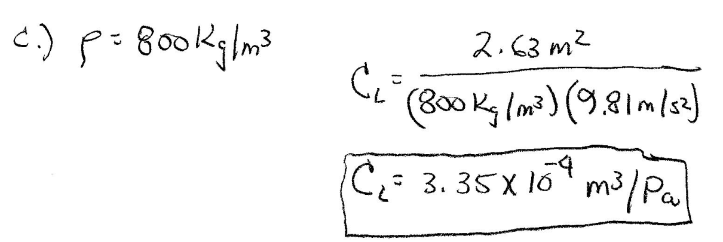
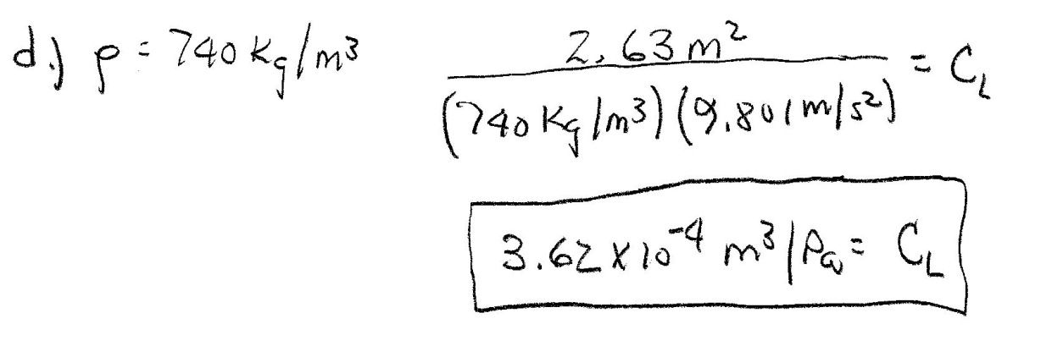
Fluid Capacitance Examples
Parts c. and d.
Note: As density of fluid decreases, the volume of liquid required to produce a unit increase in pressure increases.

Slide 20
Fluid Inertance
Amount of pressure drop required to increase flow rate by one unit/second. Analogy-electrical inductance.
Where I_{L} = inertance (Pa/(m³/s²)
p = pressure drop (Pa)
ΔQ/Δt = change in flow
Inertance defined using physical parameters of pipe.
Where: A = area of pipe (m²)
ρ = density of liquid (Kg/m³)
l = length of pipe (m)

Slide 21
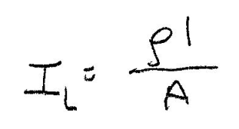
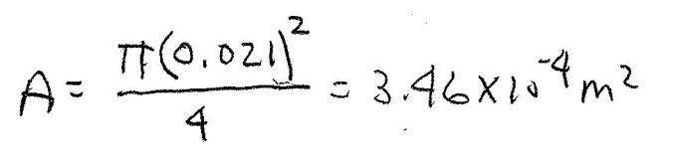
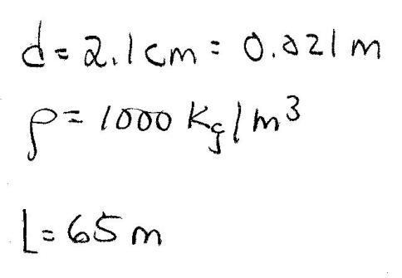
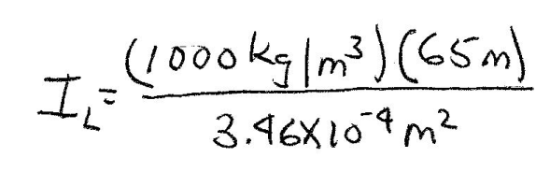
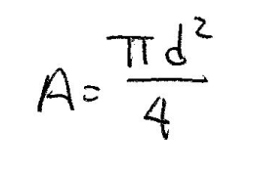
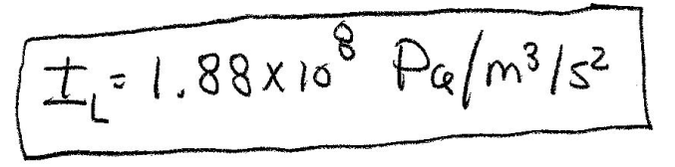
Dead-Time Delay
Dead-time Delay of Liquid - time required to transport liquid from one point to another in piping system or ducts.
v = average velocity of fluid (m/s)
D = distance traveled (m)
Example 6-4: Determine the inertance of water in a pipe with a diameter of 2.1 cm and a length of 65 meters.

Slide 22
End Lesson 6: Mathematical Models of Fluid Flow Components
ET 438a
Automatic Control Systems Technology

